Slide 1
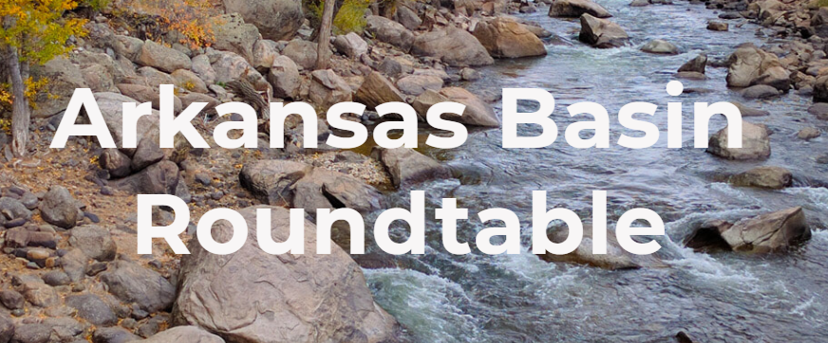
Administration of Un-decreed Ponds
Division of Water Resources Division 2 Pond Management Program
Bill Tyner, Division Engineer

Slide 2
Pond Management Program Described
A process to review ponds within the Arkansas River Basin to more-accurately manage the water supply and to meet our legal water obligations to Colorado water rights and Kansas.
Utilizing multiple sources of available data the Division Engineer’s Office has worked cooperatively with the State Engineer’s Office to identify a target set of ponds that don’t appear to fall within administration by having a senior decreed water right or by being included in a plan for augmentation or replacement plan.
The Arkansas River Basin is one of the most over-appropriated water basins in the state and has experienced frequent and severe drought conditions, (we use more water than is naturally supplied).
Addressing ponds may potentially help relieve some pressure on demand gaps by restoring water to agricultural and municipal users with senior rights.

Slide 3
Pond Management Program Strategy
Organized to begin first near the mainstem of the Arkansas River and key tributaries in each water district where addressing pond losses will provide a direct contribution to senior water rights and will positively impact our ability to maintain compliance with our Compact.
Includes an extensive effort to build educational material helpful in providing options to pond owners and providing initial notification of the problem to each owner.
Anticipates follow-up field visits by each Water Commissioner to answer questions and help determine best options for compliance.

Slide 4
Areas of focus in Phase 1 in the East Region
In Water District 67 work will begin along the Arkansas River corridor within a five mile buffer and up Caddoa and Rule Creeks
In Water District 17 work will also begin along the five mile buffer zone of the Arkansas River and up the lower Purgatoire and lower Apishapa Rivers
Water District 66, although not a Compact consideration will still get some attention along the Cimarron River and its North Fork and the North Fork of Sand Creek

Slide 5
Areas of focus in Phase 1 in the North Region
In Water District 10 work will begin along the Fountain Creek corridor (primarily within Colorado Springs’ service area) and on Black Squirrel, Jackson and Cheyenne Creeks
In Water District 14 work will begin along the five mile buffer zone of the Arkansas River (as shared with WD 10) and up the lower Huerfano River and Sixmile Creek
Water District 15, the work will begin on the St. Charles River and North St. Charles River and on Greenhorn Creek

Slide 6
Areas of focus in Phase 1 in the West Region
In Water District 11 work will begin along a one mile buffer of the Arkansas River and on Browns Creek, Chalk Creek and the South Arkansas
In Water District 12 work will begin along a one mile buffer of the Arkansas River and on Badger, West Fourmile, Miller and Slater Creeks,
In Water District 13 work will begin on Grape Creek, Texas Creek and Colony Creek

Slide 7
Areas of focus in Phase 1 in the South Region
In Water District 19 work will begin along Lorencito Creek and the North and South Forks of the Purgatoire River
In Water District 18 work will begin along the Apishapa River within a one mile buffer and on Jarosa and Trujillo Creeks
In Water District 16 work will begin on Bear Creek, Santa Clara Creek and Storey Creek
In Water District 79 work will begin along a one mile buffer zone of the Huerfano River and on Muddy Creek and Sheep Creek

Slide 8
Is this effort going on Statewide?
Although each Division Engineer in each Water Division in the State periodically works to address issues that come up associated with ponds, there is not a concerted ongoing effort underway except in the Upper Black Squirrel Designated Ground Water Basin area and in the Arkansas Basin

Slide 9
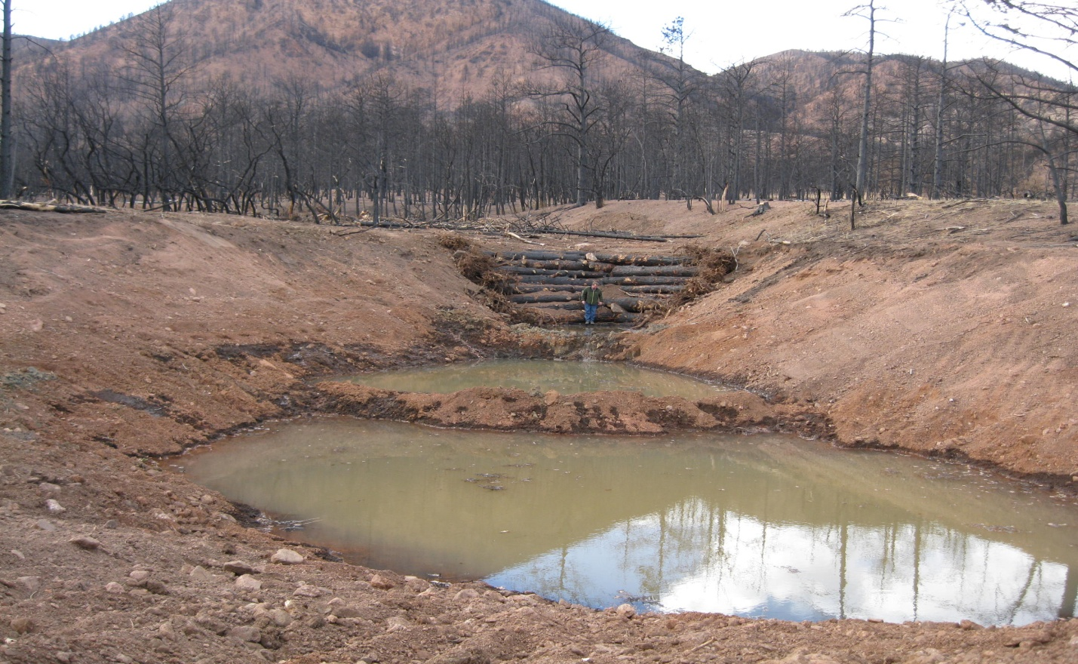
Aren’t all of these existing ponds “grandfathered in”?
There are a few limited exceptions in Colorado statutes that provide some degree of exemption. These include:
Ponds used for storm water management and post wildland fire erosion mitigation under C.R.S. §37-92-602(8)(b)(I) and (II)
Limited duration storage

Slide 10
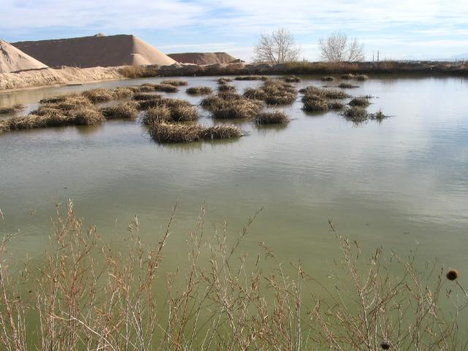
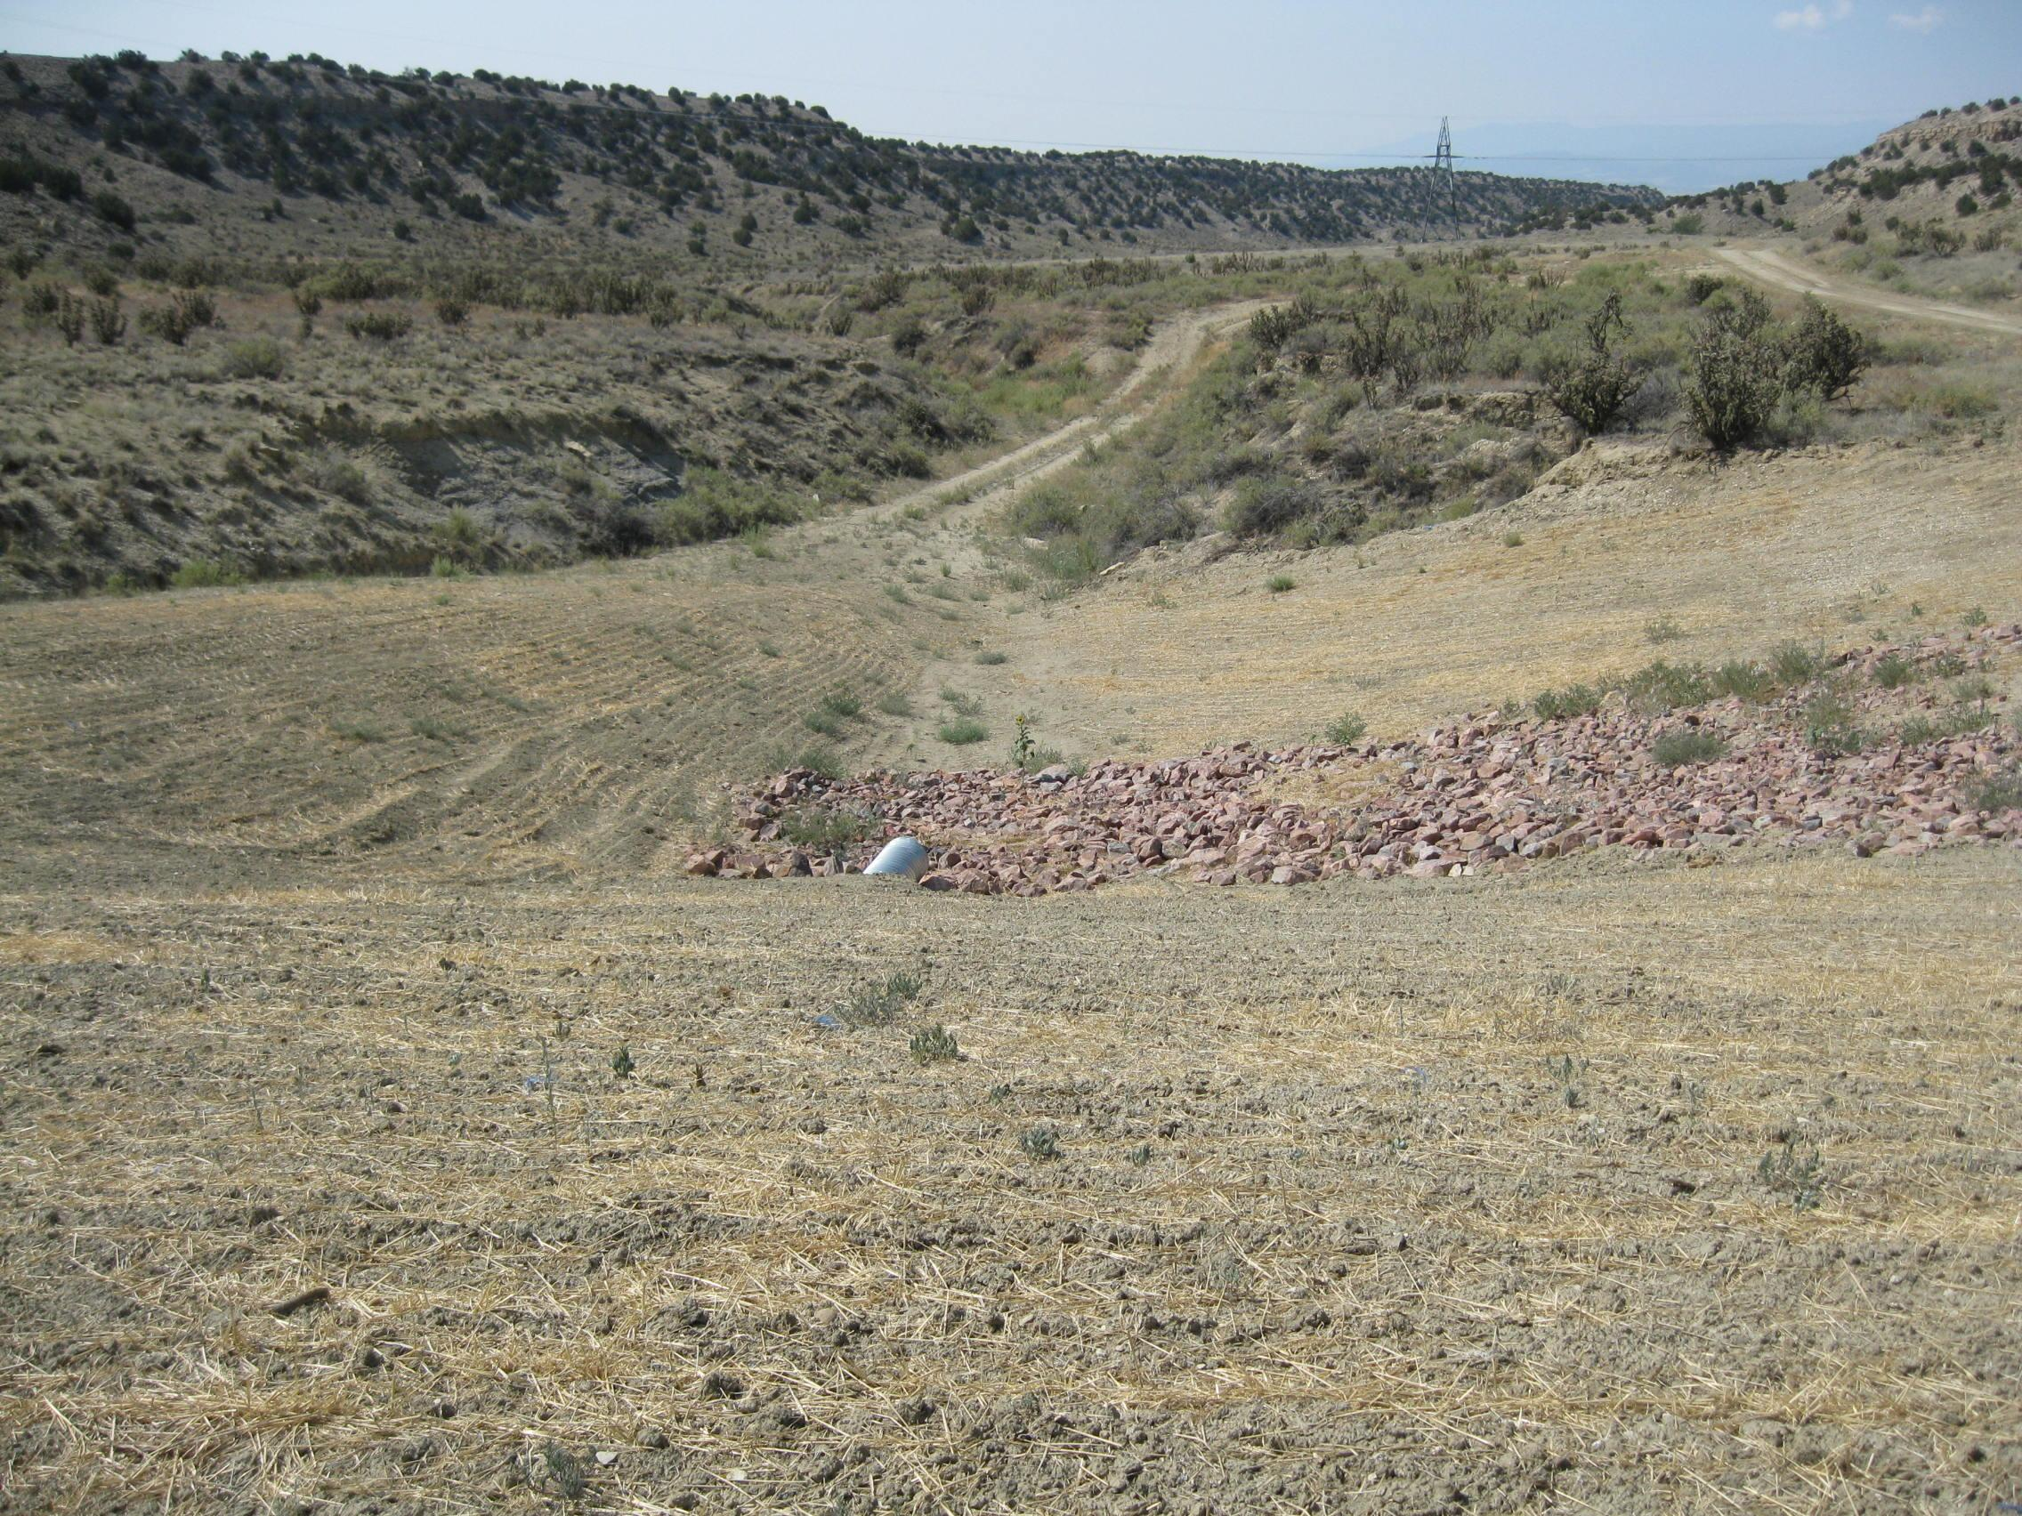
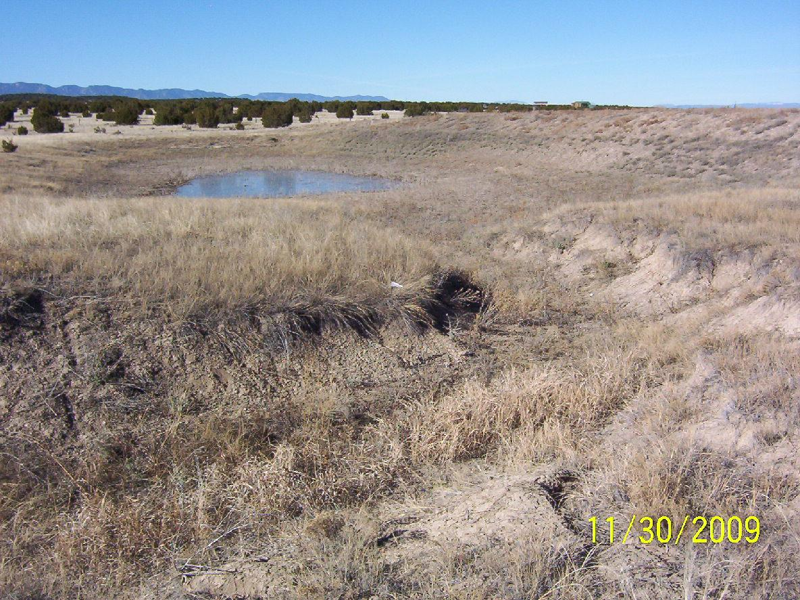
Other Exemptions Include
Colorado Revised Statutes 37-87-122 Erosion Control Dams
Colorado Revised Statutes Title 35, Article 49 Livestock Water Storage Tanks
Constructed on normally dry (80% of the time) drainages as determined by the State Engineer
Vertical dam height 15 feet or less; volume 10 acre-feet or less at emergency spillway level
Colorado Revised Statutes 37-90-137(11)(II)(b)
Ground water exposed in a gravel mining operation prior to 1981

Slide 11
Other Partial Exemptions Include
Head Stabilization Ponds
&
Tailwater Recovery Ponds
Authorized for limited use to increase efficiency of water deliveries
No long term storage (72 hours after delivery)
Subject to Irrigation Improvement Rules in the Arkansas Basin

Slide 12
How many ponds are we talking about here? When does this program roll out?
There are in excess of 10,000 ponds throughout the Arkansas Basin that require review (not including ponds in Designated Basins).
The initial Phase 1 effort will tackle a subset of this very large population in the areas presented.
Just over 300 brochures will be mailed out to pond owners beginning January 14th and followed by several other mailing dates
DWR Pond Management Information Located Here:
https://dwr.colorado.gov/services/water-administration/pond-management
Pond Brochure
Pond FAQs
Blanket Augmentation Plans

Slide 13
Options for Compliance
Vary by Location
Include Pond in an Augmentation Plan/Exchange Plan
Breach/Drain Pond
Backfill Pond (If Ground Water Exposed by Pond)
If Pond qualifies for a statutory exemption, obtain required permit and/or demonstrate with documentation
May require updating such as installation of low level outlets

Slide 14
Will getting a single pond into compliance really make a difference?

Slide 15
Getting a single pond into compliance may not produce a big impact, but just like a string of pearls that is more valuable than the pearls individually, this concerted, ongoing effort will be valuable by addressing many ponds equitably.

Slide 16
Questions?

